Slide 1
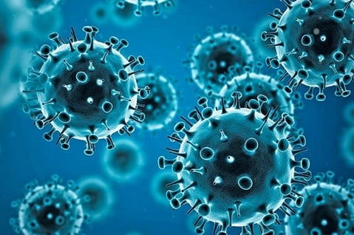
THE IMPACT OF COVID-19 ON THE GLOBAL ECONOMY.
……………………………………………………………………………..

Slide 2
INTRODUCTION
Description : The COVID-19 pandemic tossed the world into a state of uncertainty, not only from the health standpoint but also on global economy. With the global that were enacted requiring many businesses to shut down early and limiting the number of people engaged in gathering activities, this took a toll on the level of consumption and total output that builds a country’s economy. Our interest in this topic pertains to our willingness to explore the different ways and to what degree ecological forces like the global COVID-19 pandemic can affect a country’s economy both short and long term.
Notes:
Introduce dataset

Slide 3
QUESTIONS THE TEAM HOPES TO ANSWER WITH THE DATA.
Which countries were most and least affected by COVID-19?
What income group the countries affected fall into?
Is GDP per capital a determinant of cross-country differentials in impact of COVID-19?
Is HDI a determinant of cross-country differentials in impact of COVID-19?
Is population size a determinant of cross-country differentials in impact of COVID-19?
Notes:
Introduce what is expected of the team

Slide 4
DATABASE
The dataset was sourced from Mendeley data via
https://data.mendeley.com/datasets/b2wvnbnpj9/1
The following steps were taken for a successful database setup:
1. Data cleaning and preprocessing using python (Jupyter Notebook)
pgAdmin setup
Connection to postgres
Notes:
Introduce Database
Database setup

Slide 5
Data cleaning and preprocessing using python (Jupyter Notebook)
During the data cleaning, the following steps were performed:
Loading the data
Renaming the columns
Converting #NUM to NaN
Checking the numbers of NaN value
Replacing NaN values with a float
Replacing NaN for remaining columns
Description of the data in the dataset
Saving the cleaned data to a new file
Notes:
Data cleaning
Data preprocessing

Slide 6
PgAdmin database setup
A database named “covid_db” was created in the PgAdmin database to hold our data. Since we are working on only one dataset, we could not create an ERD for the work.
Notes:
PgAdmin set up

Slide 7
CONNECTION TO POSTGRES
After creating the database, the following steps were taken to interface the database, viz:
Importation of PostgreSQL instance on jupyter notebook
Setting up of password
Creation of an engine
Saving of clean data to postgres table created on pgAdmin
Notes:
Connecting to postgres

Slide 8
MACHINE LEARNING
We used supervised learning in analysis this data using linear regression.
Linear regression is typically used in predicting, forecasting, and finding relationships between quantitative data.
Regression models a target prediction value based on independent variables. In our analysis the independent variables were; stringency index, population and GDP per capita predicting total cases.
We used supervised machine learning as it allows for the discovery of insights to better understand relationships and patterns within a labeled training data set.
Herem we do have a labeled training data set already containing the known value, or answer, for the target variable of each record.
Notes:
Introduce machine learning

Slide 9
Using Machine Learning to identify the most significant variable that can be used to predict total cases
To see how variables affect the number of cases. we drop total_deaths variable due to its high correlation to the total_cases variable.
The most relevant features, are those that influence the predictor variable, total_cases, the most.
We first remove non-numeric variables; which is dropping; iso_code, location and date.
We then drop the predictor variable from the dataset.
Next is to convert the pandas dataframe to a numpy array; to enable computation and then normalize the data.
The final step is creating the linear regression model and checking for feature imprtance.
This concludes that stringency index is the highest predictor for total cases and thus total deaths.
Notes:
Identification of variables

Slide 10
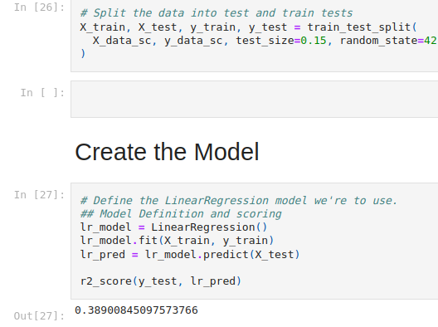
Notes:
Creation of the model

Slide 11
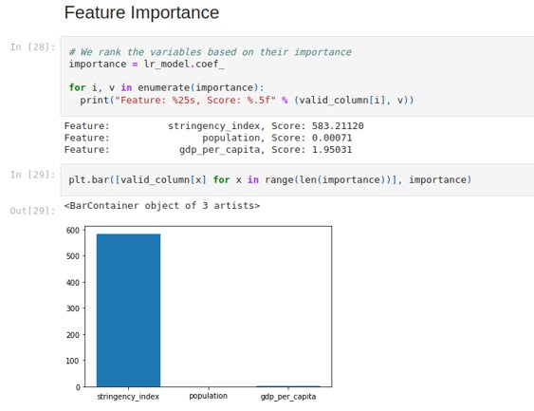
Notes:
Feature importance

Slide 12
DASHBOARD

Slide 13
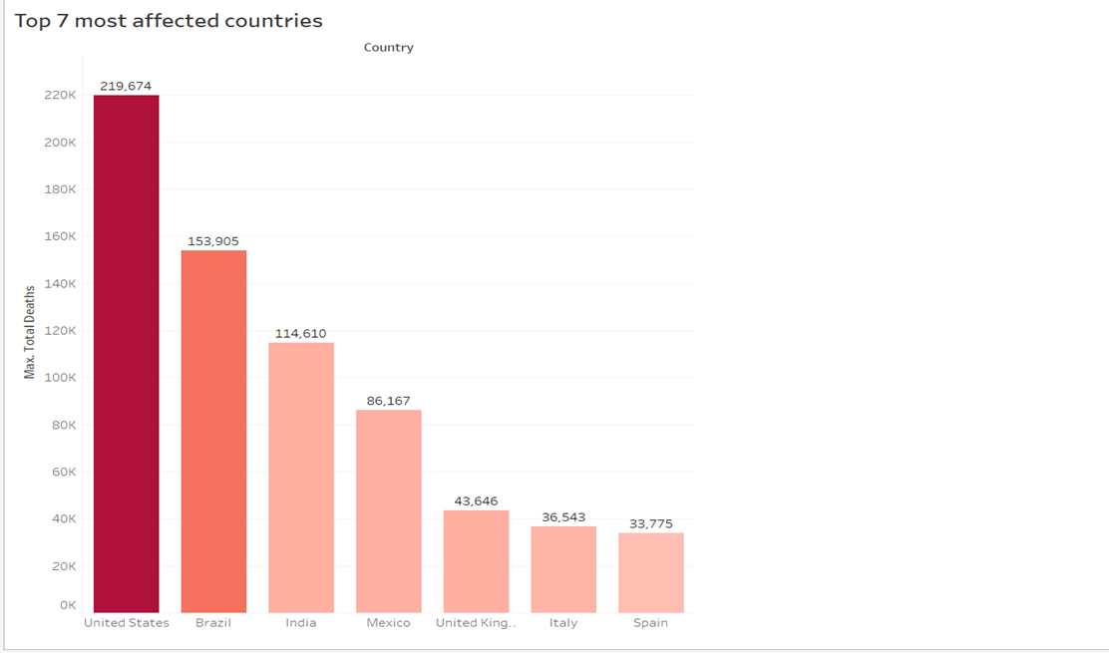
. https://public.tableau.com/app/profile/ahmed.faraz/viz/Top7mostaffectedcountries/Top7mostaffectedcountries?publish=yes
Notes:
Chart showing top 7 most affected countries

Slide 14
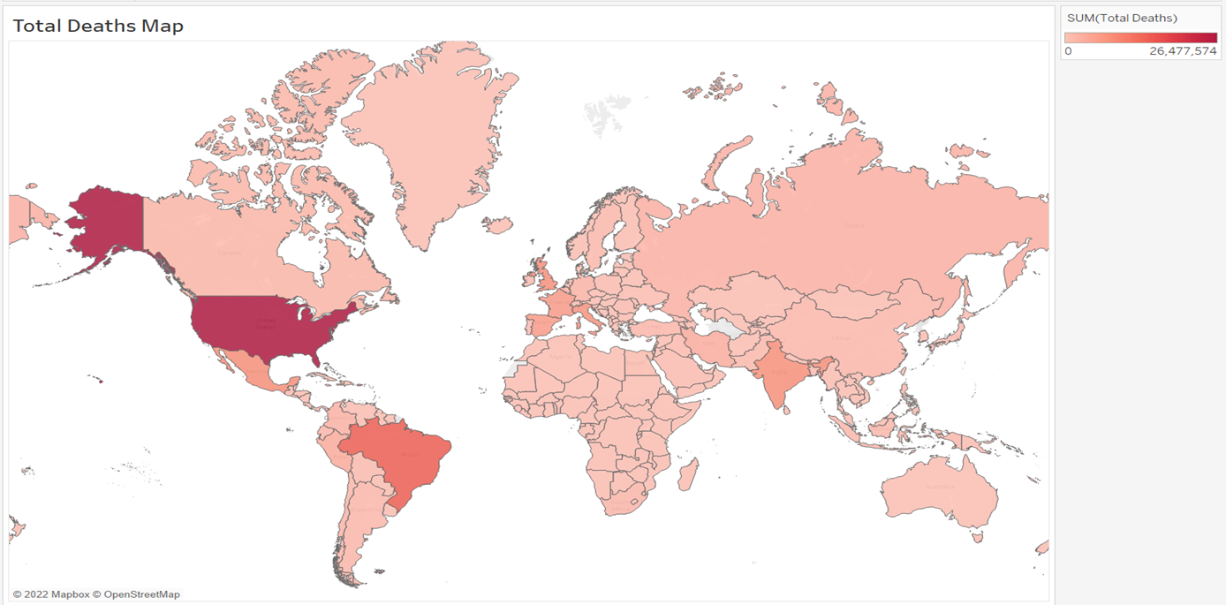
https://public.tableau.com/app/profile/ahmed.faraz/viz/TotalDeathsMap/TotalDeathsMap?publish=yes
Notes:
Map showing total death

Slide 15
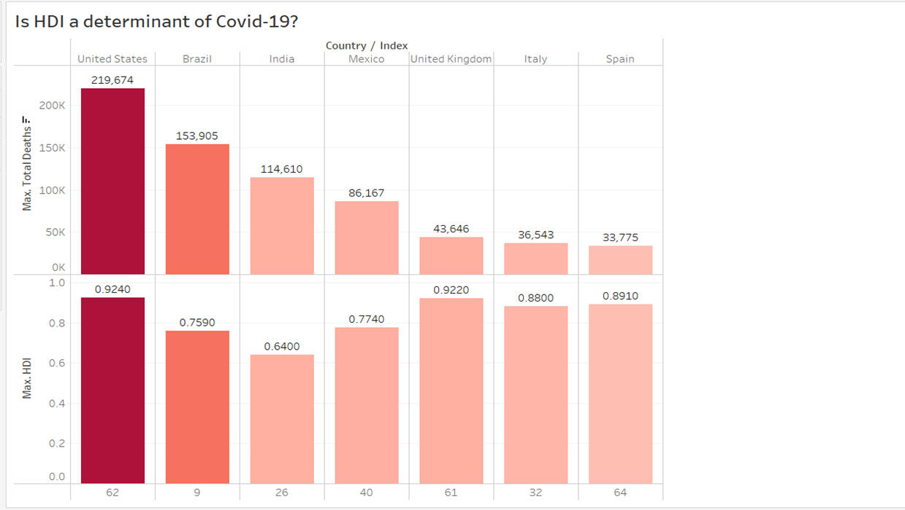
https://public.tableau.com/app/profile/ahmed.faraz/viz/IsHDIadeterminantofCovid-19/IsHDIadeterminantofCovid-19?publish=yes
Notes:
Charts shoWing HDI

Slide 16
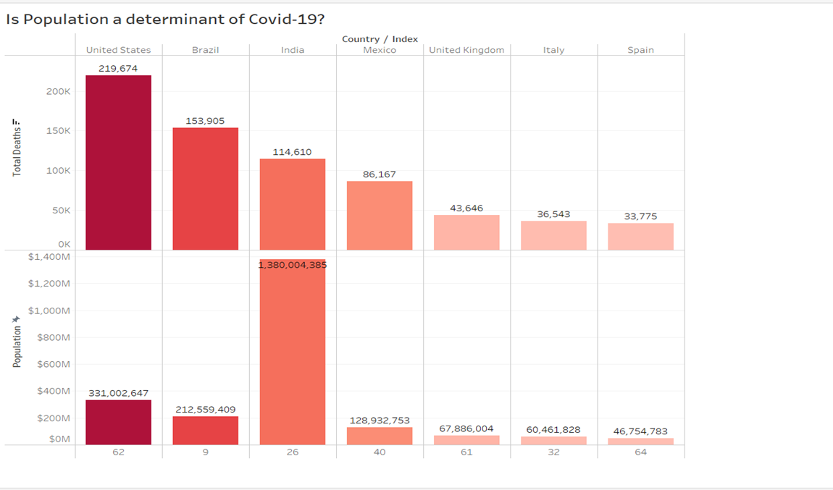
https://public.tableau.com/app/profile/ahmed.faraz/viz/IsPopulationadeterminantofCovid-19/IsPopulationadeterminantofCovid-19?publish=yes
Notes:
Charts showing population as a determinant

Slide 17
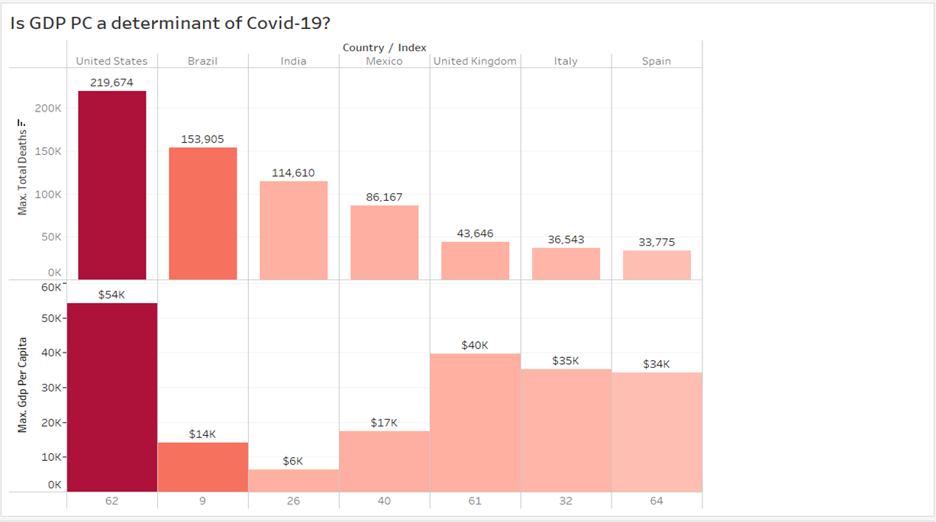
https://public.tableau.com/app/profile/ahmed.faraz/viz/IsGDPPCadeterminantofCovid-19/IsGDPPCadeterminantofCovid-19?publish=yes
Notes:
Charts showing GDP as a determinant

Slide 18
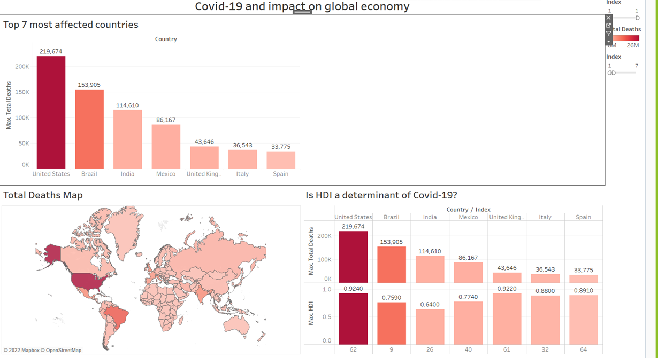
https://public.tableau.com/app/profile/ahmed.faraz/viz/Covid-19andimpactonglobaleconomy/Covid-19andimpactonglobaleconomy?publish=yes
Notes:
Map and charts showing 7 most affected countries

Slide 19
CONCLUSION
As seen in the analysis, the COVID-19 pandemic had a great impact on the world’s economy in negative ways. The maps and the charts also showed how the pandemic affected the GDP per capita, HDI and the population size generally.
However , in the final stage of the project the following softwares were used to analyse and create our dashboard, viz:
Tableau
pgAdmin/postgreSQL
2. Python/Pandas

Slide 20
Thank You!

